Slide 1
CSE322 Lecture 10 : Decidability of Automata and TMs
Last time: - Equivalence of variants of the Turing machine model
a. Multi-tape TMs
b. Nondeterministic TMs
c. Enumerators
- Church-Turing Thesis
Today: - Decision procedures for automata and TMs

Slide 2

TMs and Encodings – review
A TM has 3 possible outcomes for each input $w$:
Accept $w$ (enter $q\text{acc}$)
Reject $w$by halting (enter $q\text{rej}$ )
Reject $w$by looping (running forever)
$A$ is T-recognizable if $A=L(M)$ for some TM $M$ (might not halt on every input)
$A$ is T-decidable if $A=L(M)$ for some TM decider $M$.
halts on all inputs
$〈O_{1}, O_{2}, …, O_{k}〉$ encodes objects $O_{1}, O_{2}, …, O_{k}$ as a single string.
Notation for writing a TM $M$ is
$M=$ “On input $w$
[English description of the algorithm]”

Slide 3
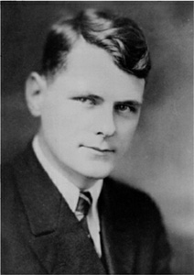
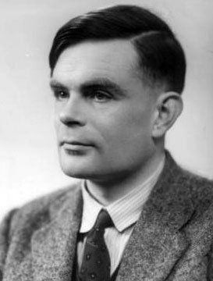

Church-Turing Thesis ~1936
=
Turing
machine
Algorithm
Intuitive
Formal
Instead of Turing machines, can use any other “reasonable” model of unrestricted computation:
$λ$-calculus, random access machine, your favorite programming language, …
Alonzo Church
1903–1995
Alan Turing
1912–1954
Big impact on mathematics.

Slide 4
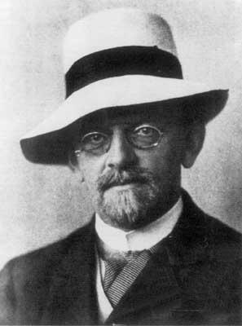

Hilbert’s 10th Problem
Diophantine equations:
Equations of polynomials where solutions must be integers.
Example: $3x^{2}−2xy−y^{2}z=7$ solution: $x=1, y=2, z=−2$
Let $D=\left\{p\right|$ polynomial $p\left(x_{1}, x_{2}, …, x_{k}\right)=0$ has a solution in integers)
Hilbert’s 10th problem: Give an algorithm to decide $D$.
Matiyasevich proved in 1970: $D$ is not decidable.
Note: $D$ is T-recognizable.
David Hilbert
1862—1943

Slide 5

Notation for encodings and TMs
Notation for encoding objects into strings
- If $O$ is some object (e.g., polynomial, automaton, graph, etc.), we write $〈O〉$ to be an encoding of that object into a string.
- If $O_{1}, O_{2}, …, O_{k}$ is a list of objects then we write $〈O_{1}, O_{2}, …, O_{k}〉$ to be an encoding of them together into a single string.
Notation for writing Turing machines
We will use high-level English descriptions of algorithms when we describe TMs, knowing that we could (in principle) convert those descriptions into states, transition function, etc. Our notation for writing a TM $M$ is
$M=$ “On input $w$
[English description of the algorithm]”

Slide 6
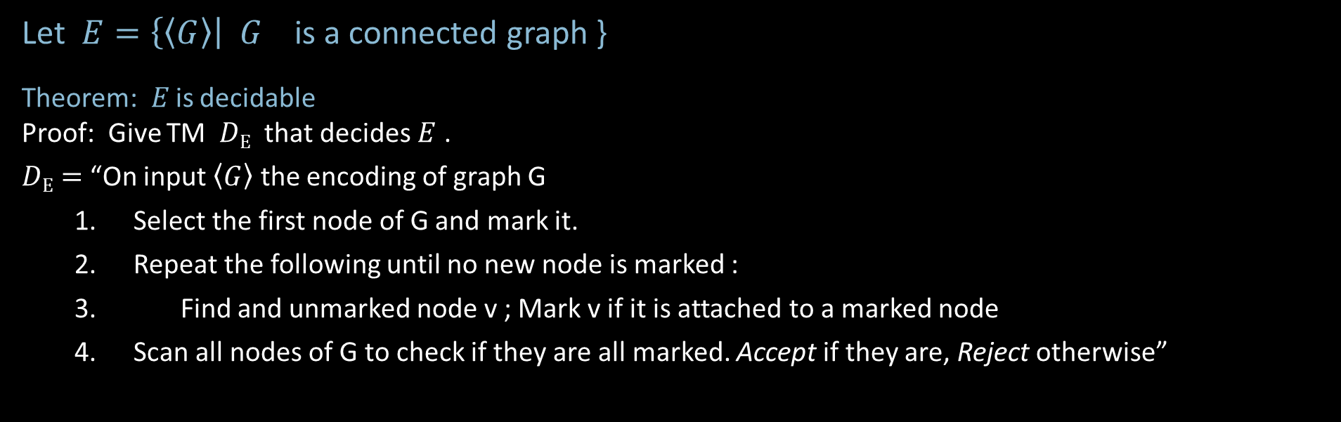
A Simple Decidable Language
Let $E=\left\{\left\langle G\right\rangle \right|$ $G_{}$is a connected graph }
Theorem: $E$is decidable
Proof: Give TM $D\text{E}$ that decides $E$ .
$D\text{E}=$ “On input $\left\langle G\right\rangle$ the encoding of graph G
Select the first node of G and mark it.
Repeat the following until no new node is marked :
Find and unmarked node v ; Mark v if it is attached to a marked node
Scan all nodes of G to check if they are all marked. Accept if they are, Reject otherwise”

Slide 7






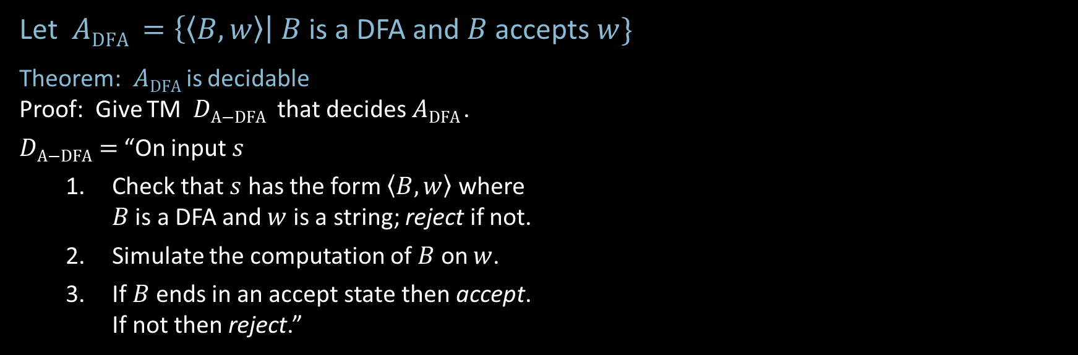

Acceptance Problem for DFAs
Let $A\text{DFA} =\left\{〈B,w〉\right| B$ is a DFA and $B$ accepts $w\}$
Theorem: $A\text{DFA}$is decidable
Proof: Give TM $D\text{A}\text{−}\text{DFA}$ that decides $A\text{DFA}$.
$D\text{A}\text{−}\text{DFA}=$ “On input $s$
Check that $s$ has the form $〈B,w〉$ where $B$ is a DFA and $w$ is a string; reject if not.
Simulate the computation of $B$ on $w$.
If $B$ends in an accept state then accept. If not then reject.”
Shorthand: On input $〈B,w〉$
input tape contains $〈B,w〉$
$$\left(Q=\left\{q_{0}, …,q_{k}\right\}, Σ=\left\{0,1\right\}, δ=⋯, q_{0}, F=⋯\right), w=01101$$
$$D\text{A}\text{−}\text{DFA}$$
$$B$$
$$w$$
$$q_{i }, k$$
work tape with current state and input head location

Slide 8

Acceptance Problem for NFAs
Let $A\text{NFA} =\left\{〈B,w〉\right| B$ is a NFA and $B$ accepts $w\}$
Theorem: $A\text{N}\text{FA}$is decidable
Proof: Give TM $D\text{A}\text{−}\text{NFA}$ that decides $A\text{N}\text{FA}$.
$D\text{A}\text{−}\text{NFA}=$ “On input $〈B,w〉$
Convert NFA $B$ to equivalent DFA $B′$.
Run TM $D\text{A}\text{−}\text{DFA}$ on input $〈B′,w〉$. [ Recall that $D\text{A}\text{−}\text{DFA}$ decides $A\text{D}\text{FA}$ ]
Accept if $D\text{A}\text{−}\text{DFA}$ accepts. Reject if not.”
New element: Use conversion construction and previously constructed TM as a subroutine.

Slide 9

Emptiness Problem for DFAs
Let $E\text{DFA}=\left\{〈B〉\right| B$ is a DFA and $L\left(B\right)=∅\}$
Theorem: $E\text{D}\text{FA}$is decidable
Proof: Give TM $D\text{E}\text{−}\text{DFA}$ that decides $E\text{DFA}$ .
$D\text{E}\text{−}\text{DFA}=$ “On input $〈B〉$ [IDEA: Check for a path from start to accept.]
Mark start state.
Repeat until no new state is marked:
Mark every state that has an incoming arrow from a previously marked state.
Accept if no accept state is marked. Reject if some accept state is marked.”

Slide 10



Equivalence problem for DFAs
Let $EQ\text{DFA}$ $=\{〈A,B〉|$ $A$ and $B$ are DFAs and $L\left(A\right)=L\left(B\right)\}$
Theorem: $EQ\text{D}\text{FA}$is decidable
Proof: Give TM $D\text{E}\text{Q}\text{−}\text{DFA}$ that decides $EQ\text{DFA}$ .
$D\text{E}\text{Q}\text{−}\text{DFA}=$ “On input $〈A,B〉$ [IDEA: Make DFA $C$ that accepts $w$ where $A$ and $B$ disagree.]
Construct DFA $C$ where $L\left(C\right)=\left(L\left(A\right)∩\overline{L\left(B\right)}\right)∪\left(\overline{L\left(A\right)}∩L\left(B\right)\right)$.
Run $D\text{E}\text{−}\text{DFA}$ on $〈C〉$ .
Accept if $D\text{E}\text{−}\text{DFA}$accepts. Reject if $D\text{E}\text{−}\text{DFA}$ rejects.”
$$L\left(A\right)$$
$$L\left(B\right)$$
Symmetric difference

Slide 11



Acceptance Problem for TMs
Let $A\text{TM}$ $=\{〈M,w〉| M$ is a TM and $M$ accepts $w\}$
Theorem: $A\text{TM}$is not decidable
Proof: Thursday.
Theorem: $A\text{TM}$is T-recognizable
Proof: The following TM $U$ recognizes $A\text{TM}$
$U=$ “On input $〈M,w〉$
Simulate $M$ on input $w$.
Accept if $M$ halts and accepts.
Reject if $M$ halts and rejects.
Reject if $M$ never halts.”
Von Neumann said $U$inspired the concept of a stored program computer.
Turing’s original “Universal Computing Machine”
Description of $M$, input $w$
$$U$$
Not a legal TM action.

